Slide 2
Build Code Lab UWP Development 2: more personal Computing
L725
Andy Wigley @andy_wigley
Mike Taulty @mtaulty

Slide 3
Proctors
Proctors are here to help you!
Raise your hand if you need any assistance
Jason Short DX
Juliette Weiss Design
Kelsey Huebner DX
Cory Hendrixson Windows Development Group
Travis Wilson Windows Development Group
Vishwac Sena Kannan Windows Development Group
Francis Zhou Inking
Dorrene Brown Cortana
Shawn Henry Windows Development Group
Paul Rambo Windows Development Group

Slide 4
UWP Lab Modules
1
Building an Adaptive UI
2
More Personal Computing
(Follows on from Module 1, but can be done independently)
3
Building Connected Mobile Experiences: Cloud and App to App (Follows on from Module 2, but can be done independently)
Notes:
“As a follow-on to this lab, we also have the Azure IoT lab. In that, you’ll learn how to use the Raspberry Pi to send sensor data to IoT Hub and process it using other Azure IoT services.
If you are interested in the underlying IO and other capabilities on devices like the Raspberry Pi, or want to explore more with Azure and devices, we also have the Open Hack in this same room, starting on Day 2.”

Slide 5
UWP Code Lab Related Sessions Wednesday 03/30
11:30 – 12:30 | Universal App Model Overview: What’s New in the UWP App Model Marriott 9
14:00 – 15:00 | What’s New in Windows UI/UX for Universal Windows Apps Moscone 2004
15:30 – 16:30 | Bringing Existing Desktop Applications to UWP Moscone 2004
17:00 – 18:00 | Windows Store and Dev Center Overview: New Capabilities for Helping Developers Succeed Moscone 2001

Slide 6
UWP Code Lab Related Sessions Thursday 03/31
11:30 – 12:30 | What’s new in Visual Studio for UWP Developers Marriott 7
14:00 – 15:00 | Pen and Inking: Inking at the Speed of Thought Marriott 8
15:30 – 16:30 | Creating Beautiful UX in a Real World App with Visuals, Animations and Effects Moscone 2001
17:00 – 18:00 | Building Great UWP Apps for Xbox Marriott 8 | Cortana: Step-by-Step on How to Teach Cortana to Proactively Engage with your App Moscone 2005
18:30 – 19:30

Slide 7
UWP Code Lab Related Sessions Friday 04/01
09:00 – 10:00 | Universal Windows Application Lifecycle: From Activation to Background Execution, Multitasking and Extended Execution Moscone 2005
10:30 – 11:30 | HoloLens: Building UWP 2D Apps Marriott 9
12:30 – 13:30
14:00 – 15:00 | Continuum for phone: Optimizing Windows apps across screens Moscone 2001

Slide 8
In this module…

Slide 9
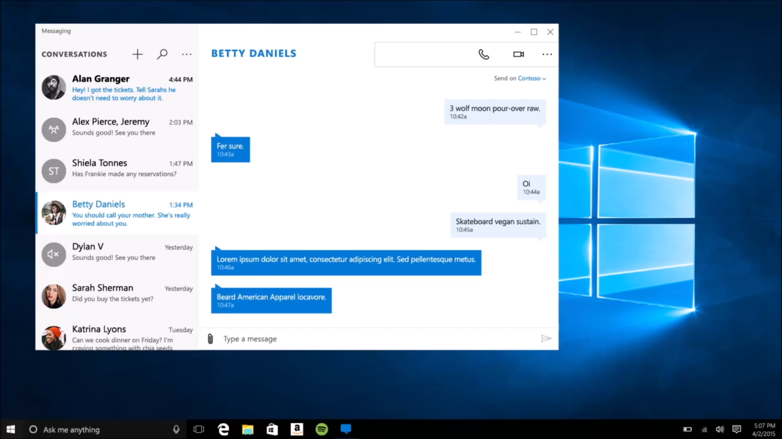
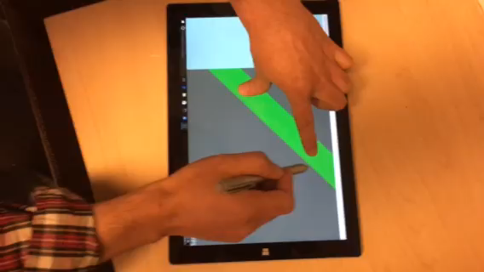
Inking
<InkCanvas x:Name=“myInkCanvas”>
Ink Tool Bar
Easy to implement
Consistent Experience
Multimodal
Simultaneous Pen and Touch Support

Slide 10
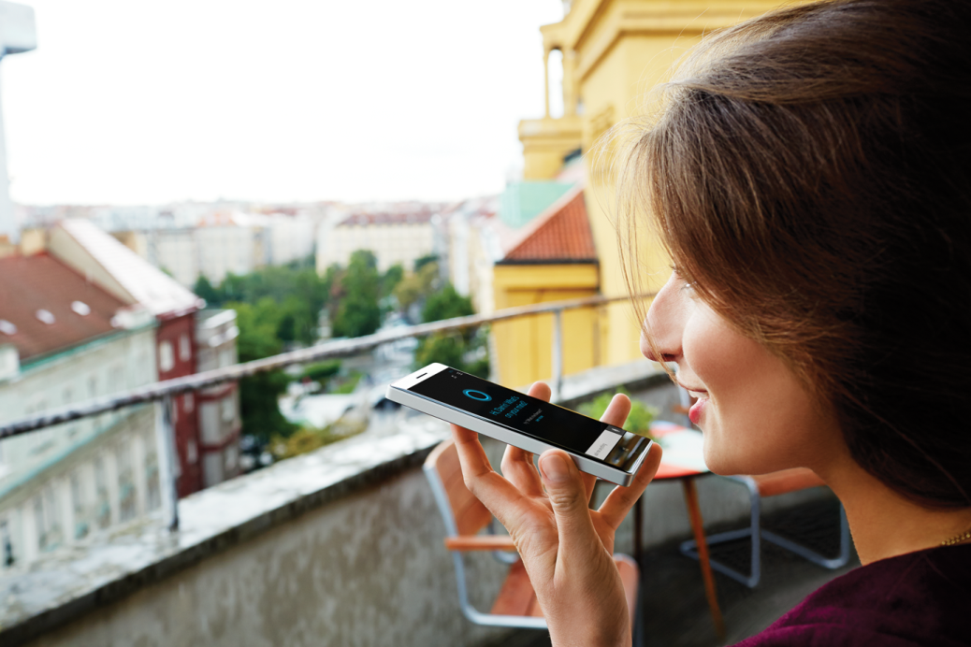
Cortana
Teach Cortana to use your app on my behalf and
contextually activate your app
retrieve information or execute an action
without loosing focus
Notes:
But what if you do want to use Cortana?
Windows Phone 8.1 developers have been able to add these features for a while, but now it’s becoming available on desktop too.
You can get Cortana to launch your app using voice commands.
But on Windows 10, we’ve extended these capabilities as well, so there is now the ability for Cortana to interact with your apps’ background task, to exchange information with it. This is great, as it allows your user to perform speech interactions with your app without your foreground app being launched at all, making natural, speech-driven interactions with your app easy for your users.

Slide 11
Getting setup…

Slide 12
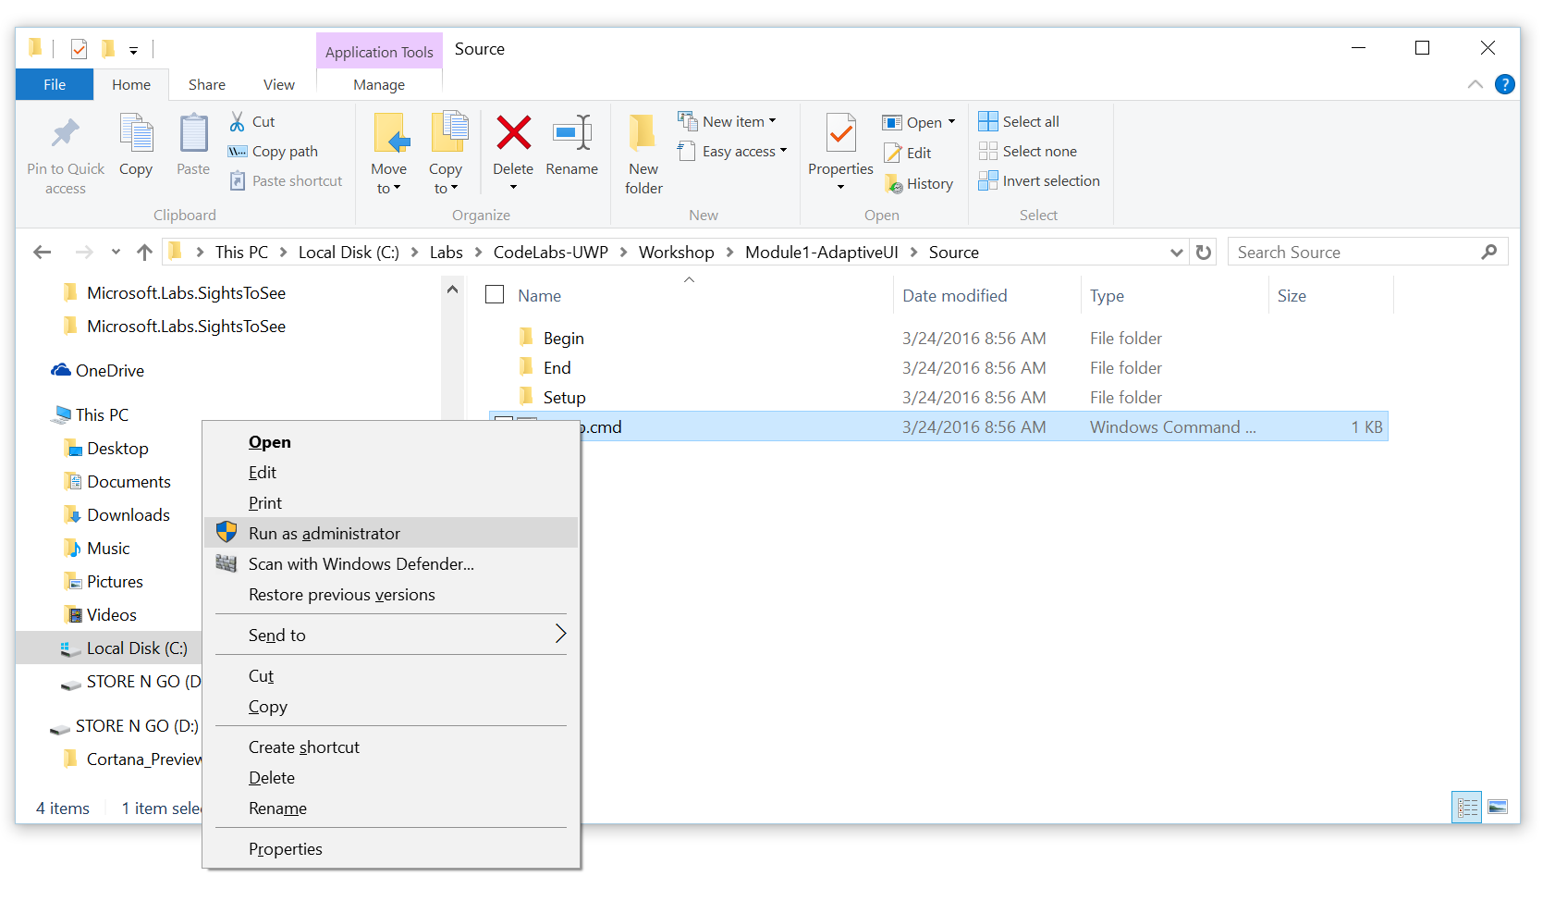
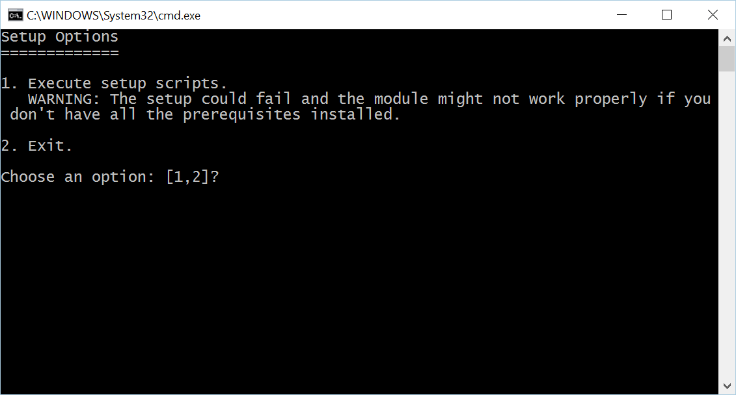
Install Code Snippets
Go to C:\Labs\CodeLabs-UWP\Workshop\Module2-MorePersonalComputing\Source
Right-click on Setup.cmd, click on Run as administrator
Click Yes at the User Account Control prompt
Select option 1 in the command window

Slide 13
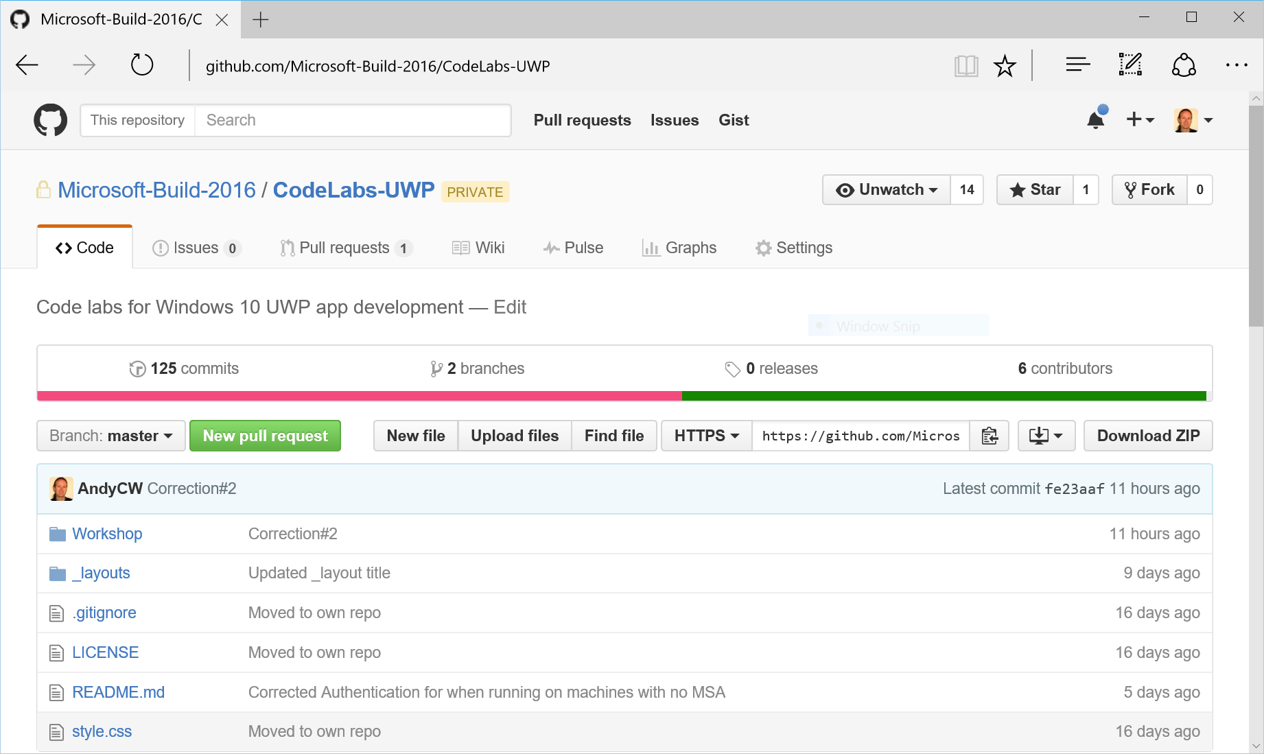
View lab manual
On your desktop, click the UWP CodeLabs icon to open the browser at the Github repository for these labs: https://github.com/Microsoft-Build-2016/CodeLabs-UWP
Click on Workshop folder

Slide 14
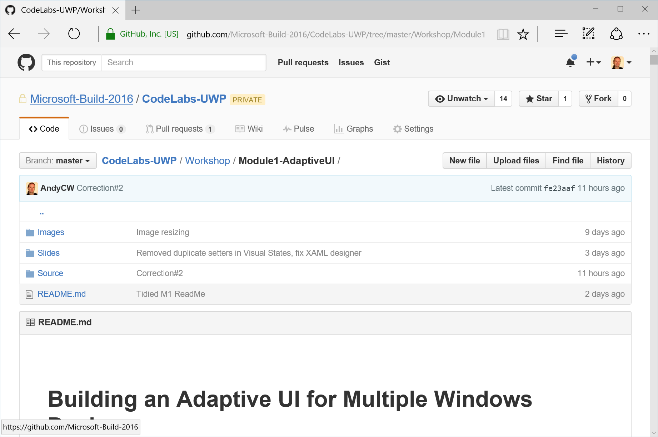
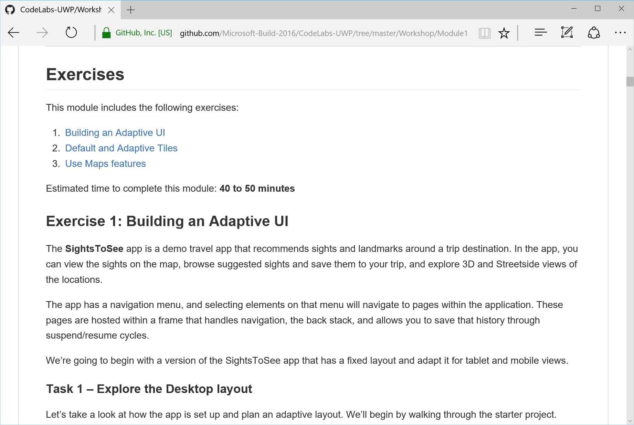
View lab manual
Click on the folder for the current module
Scroll down for the README.md – this is your lab manual

Slide 15
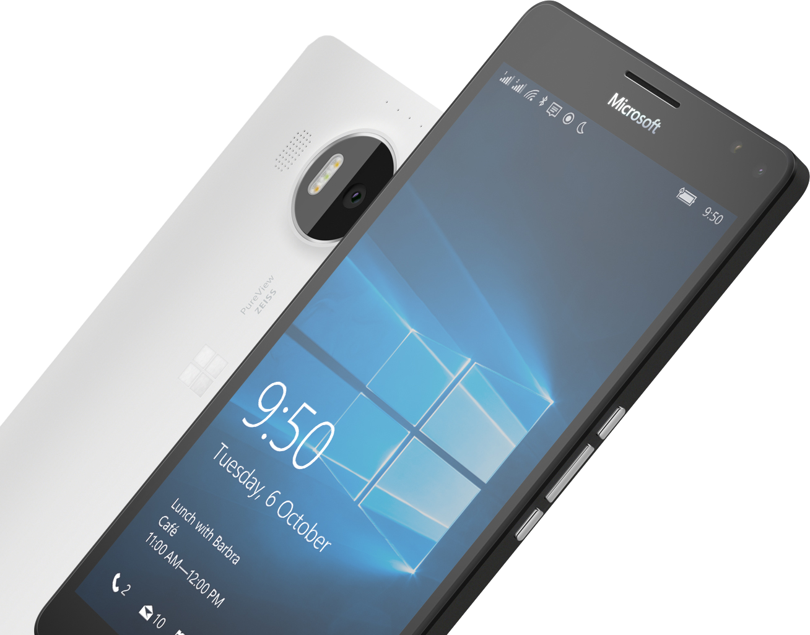
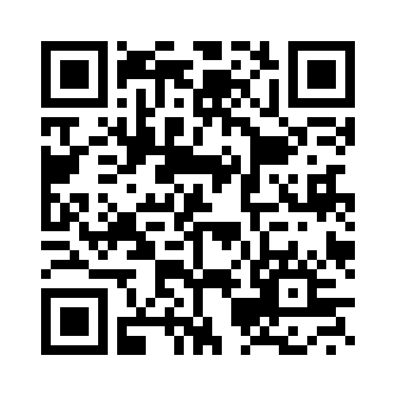
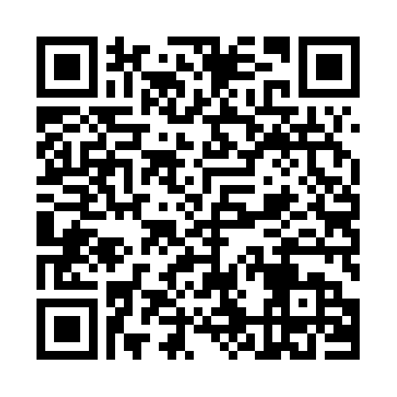

Please Complete An Evaluation Form Your input is important!
SAMPLE
or
Notes:
Update phone image to a Microsoft phone.

Slide 16
Evaluate this session
SAMPLE
Notes:
Speakers: Please note this slide will be updated with your session’s QR code during the scrub process which is outlined on side 3. Attendees can scan the QR code for access to your session’s eval.

